Slide 1
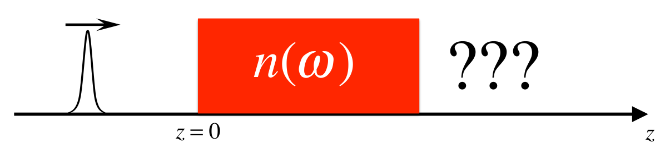
Propagation of pulses in dispersive media
Fabien Bretenaker, Antoine Browaeys, Ondes électromagnétiques, 2016

Slide 2

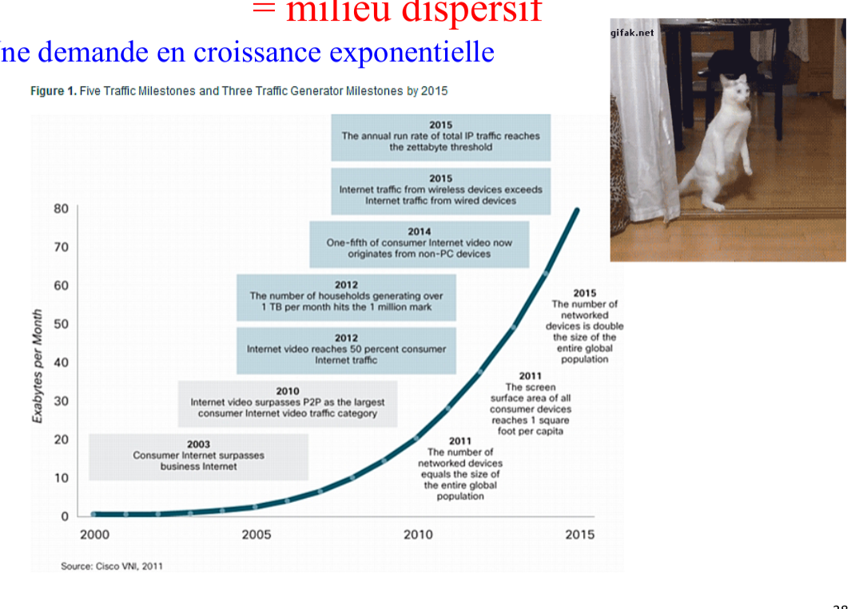
why do we use the propagation of pulses in dispersive media?
In telecommunications, for example, understanding dispersion is essential for optimising the fibre-optic networks that form the backbone of our Internet communications.
Even if the non-linear effects in conventional fibers are very weak, they are still present, since pulses propagate over large distances and cannot be neglected.

Slide 3
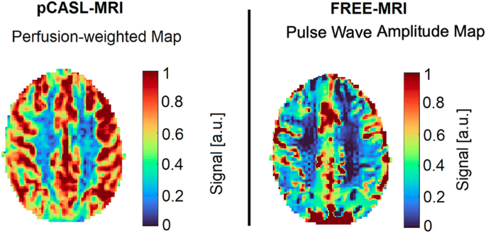
why do we use the propagation of pulses in dispersive media?
In addition, advanced medical techniques, such as magnetic resonance imaging (MRI) and some forms of ultrasound imaging, also depend on our understanding of pulse dispersion to produce clear and accurate images.
The ability to predict and manipulate how pulses propagate through different tissues may be key to effectively diagnosing and treating various diseases.

Slide 4

why do we use the propagation of pulses in dispersive media?
Dispersion in this context is essentially the dependence of the refractive index of the material on the frequency of the light.
This phenomenon affects how and to what depth different wavelengths of light are absorbed in the semiconductor material.
In a solar cell, optimising dispersion means maximising the absorption of light at different wavelengths to increase photovoltaic conversion efficiency.
renewable energy & solar cells

Slide 5
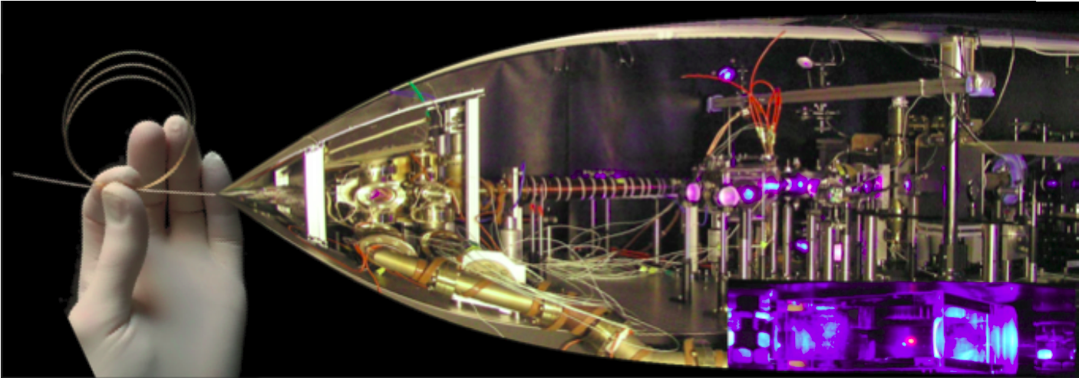
why do we use the propagation of pulses in dispersive media?
Allows us to describe the propagation of an electric field along z in 3D and 1D in a Rubidium cell

Slide 6
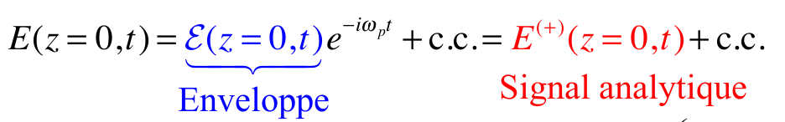
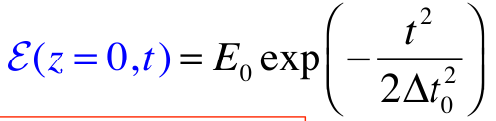
Description of the impulse upon entering the medium
Consider a Gaussian pulse propagating along the z-axis. At z=0, on a dispersive medium:
Envelope
Analytical signal
with a Gaussian envelope given by :

Slide 7
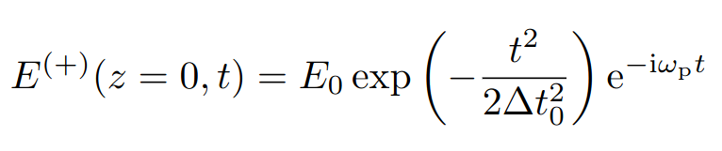
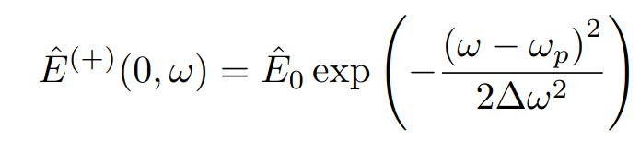
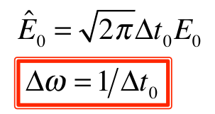
Description of the impulse upon entering the medium
The positive frequency part of the signal, also known as the "analytical signal" is:
FT
The Fourier transform of this analytical signal, which is also the positive frequency part of the electric field, is given by :
With:
The shorter the pulse, the wider the spectrum!
Notes:
Spectral width

Slide 8
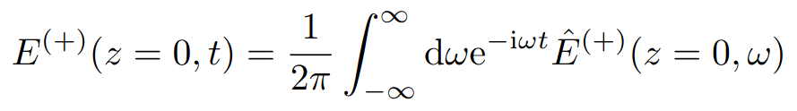
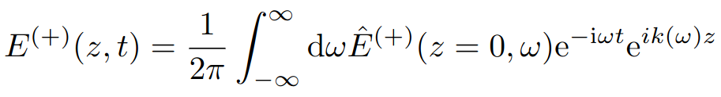
Description of the impulse upon entering the medium
The impulse upon entering the dispersive medium can be seen as a sum of monochromatic waves:
Propagation over a length z, each spectral component acquires a phase k(ω)z:

Slide 9
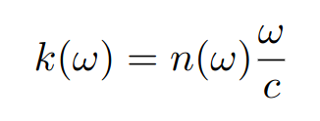
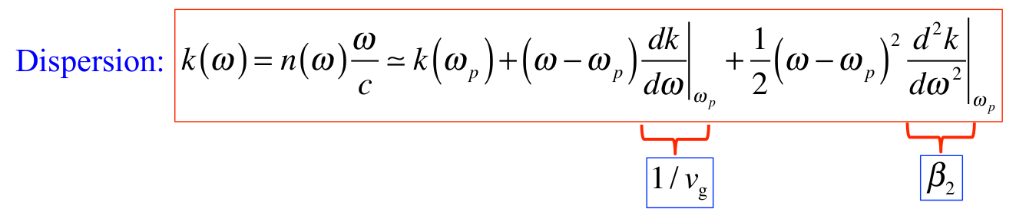
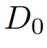
Dispersion of the medium
From the dispersion relation in a dielectric medium, we get:
By performing a second-order Taylor expansion around the center frequency ⍵_{p} of the pulse spectrum, we obtain:

Slide 10
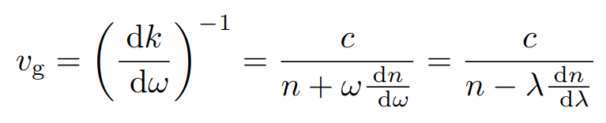
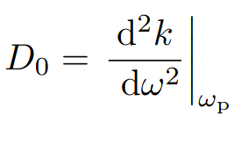
Dispersion of the medium
The second term of this development allows us to deduce the group velocity:
The third term is called the second-order dispersion or group velocity dispersion:

Slide 11
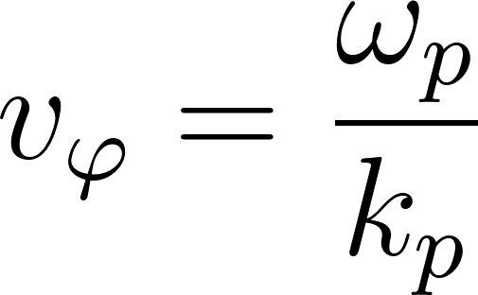
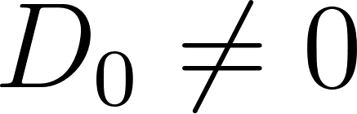
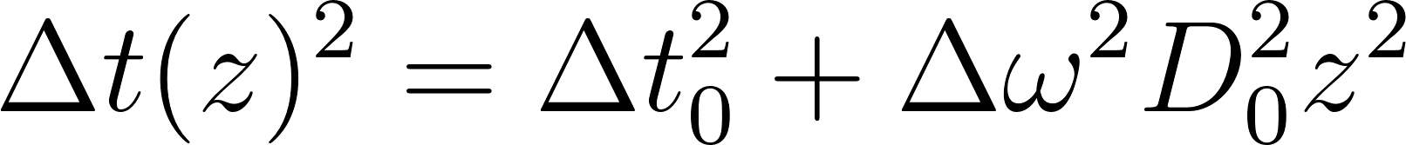
Propagation of a Gaussian pulse
Envelope propagation at v_{g}
: wave packet spread
: chirp
Fabien Bretenaker, Antoine Browaeys, Ondes électromagnétiques, 2016

Slide 12
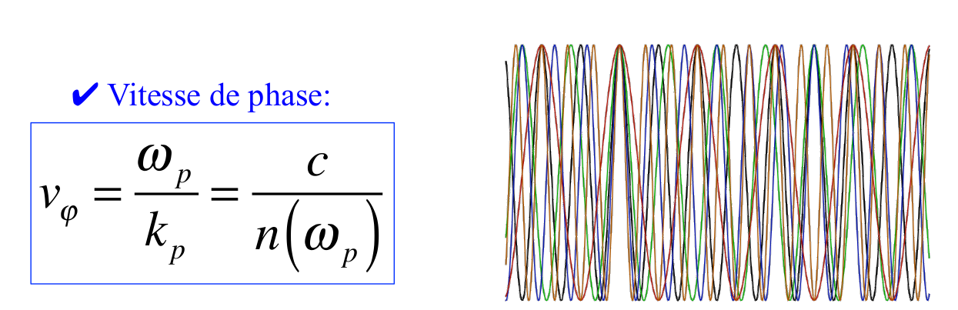
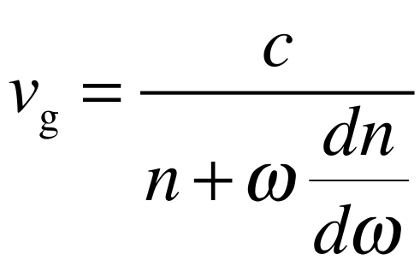
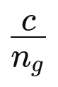
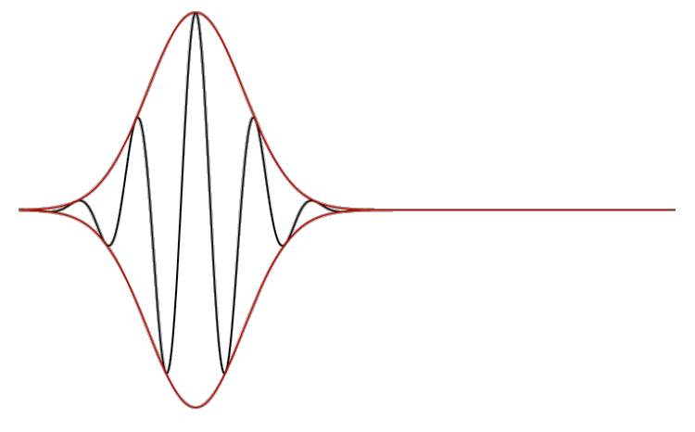
Phase velocity and group velocity
Describes the speed at which the phase plan propagates through a given medium.
Describes the speed at which the envelope of a pulse propagates through a given medium.
Pulse Propagation in Dispersive Media, Rutgers university

Slide 13
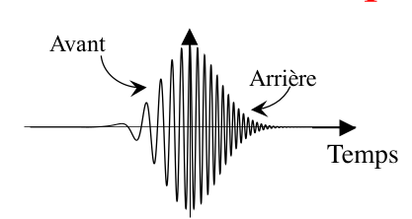
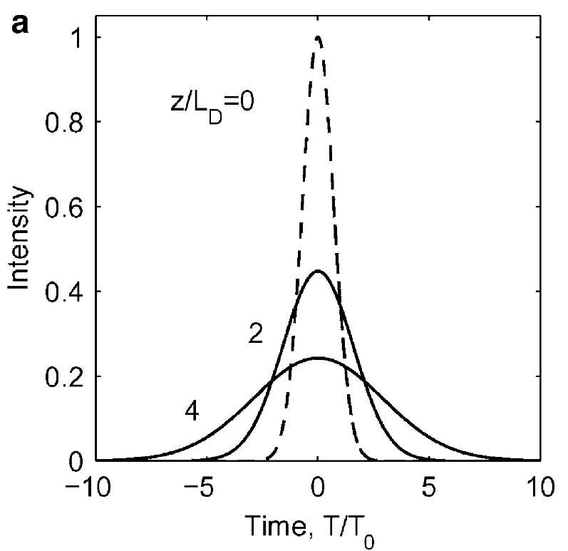
Group velocity dispersion (GVD)
Front
Responsible for pulse spreading and the appearance of a frequency chirp (variation of the instantaneous frequency along time)
The pulse widens because the different spectral components do not have the same group velocity.
Frequency-dependent
Back
Time
Govind P. Agrawal, Ultrashort Pulse Propagation in Nonlinear Dispersive Fibers, 2022

Slide 14
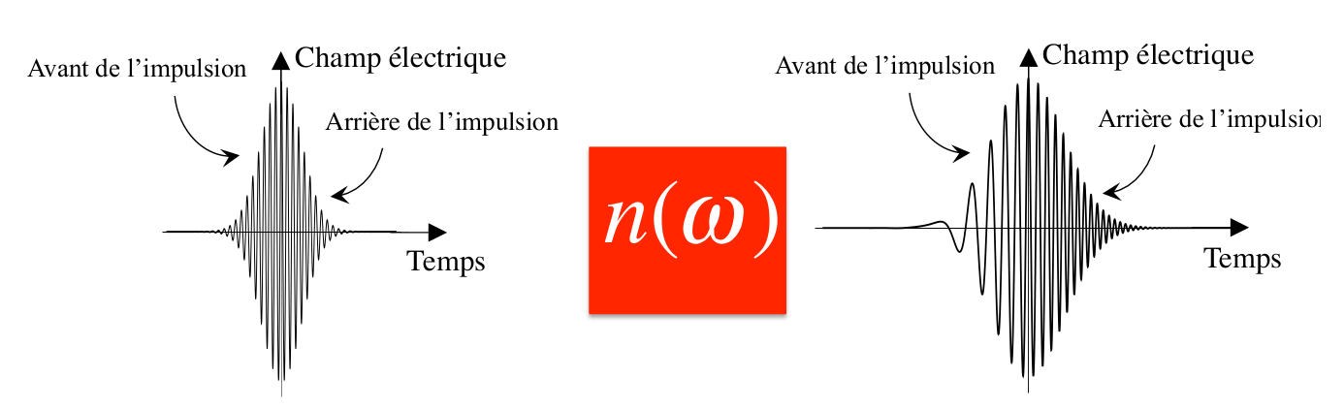
Group velocity dispersion (GVD)
Electric field
In media with positive dispersion, the pulse acquires a positive chirp when propagating in an optical medium.
High frequencies propagate less quickly than low frequencies
Blue frequency acquires propagation delay compared to red frequency
Front
Electric field
Front
Back
Back
Time
Time
Fabien Bretenaker, Antoine Browaeys, Ondes électromagnétiques, 2016

Slide 15
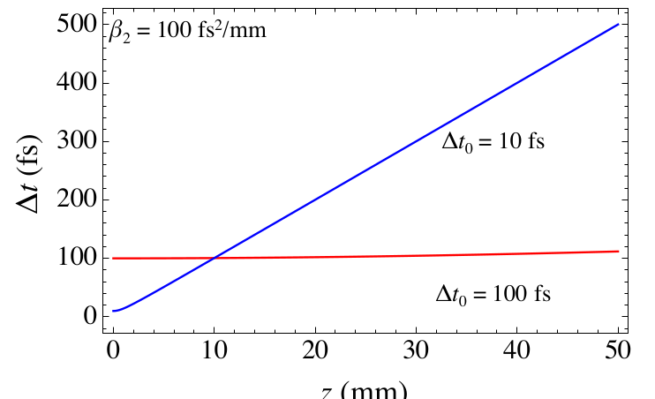
Group velocity dispersion (GVD)
The shorter (and therefore spectrally wider) the pulse, the greater the delay.
An impulse spreads faster when it is shorter at the start, when all its spectral components were superimposed in time
z (mm)
Fabien Bretenaker, Antoine Browaeys, Ondes électromagnétiques, 2016

Slide 16
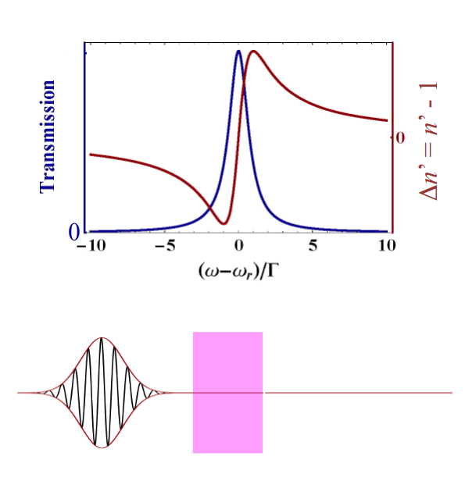
Normale dispersion : slow light
Normale dispersion
Positive dispersion
Slow light
v_{g}< c
Fabien Bretenaker, Antoine Browaeys, Ondes électromagnétiques, 2016

Slide 17
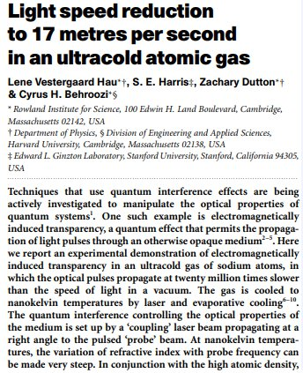
Normale dispersion : slow light
v_{g}< c
The pulse envelope propagates more slowly than the speed of light in a vacuum.
The experiment, based on controlled atomic resonances, exacerbated positive dispersion to the point of reducing the group velocity of light to almost zero.
Lene Vestergaard Hau and al., Light speed reduction to 17 metres per second in an ultracold atomic gas, 1999

Slide 18
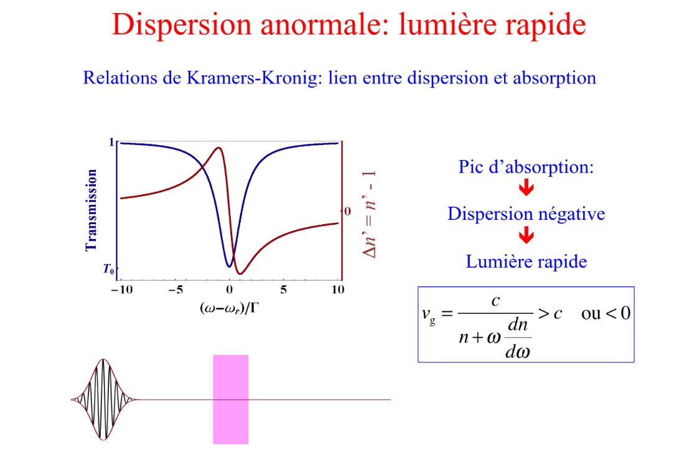
Anomalous dispersion : fast light
Anomalous dispersion
Negative dispersion
Fast light
v_{g}<0 or v_{g}>c
Fabien Bretenaker, Antoine Browaeys, Ondes électromagnétiques, 2016

Slide 19
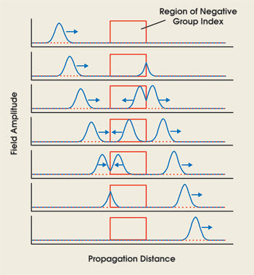
Anomalous dispersion : fast light
v_{g}<0 or v_{g}>c
We can also find situations where the medium is sufficiently dispersed for vg to exceed c or even become negative.
In this case, the pulse envelope propagates backwards in the medium, and a pulse leaves the medium with a negative group delay.
Daniel J. Gauthier and Robert W. Boyd, Fast Light, Slow Light and Optical Precursors: What Does It All Mean?, 2007

Slide 20
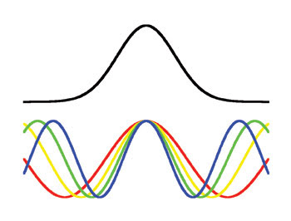
Anomalous dispersion : fast light
v_{g}<0 or v_{g}>c
A pulse can be thought of as the result of constructive and destructive interference between its various Fourier (frequency) components.
At the peak of the pulse, these components add up in phase, whereas they interfere destructively in the temporal edge of the pulse
Daniel J. Gauthier and Robert W. Boyd, Fast Light, Slow Light and Optical Precursors: What Does It All Mean?, 2007

Slide 21
Anomalous dispersion : fast light
v_{g}<0 or v_{g}>c
In a material with a frequency-dependent refractive index, each frequency propagates with a different phase velocity, thereby modifying the nature of the interference.
Daniel J. Gauthier and Robert W. Boyd, Fast Light, Slow Light and Optical Precursors: What Does It All Mean?, 2007

Slide 22
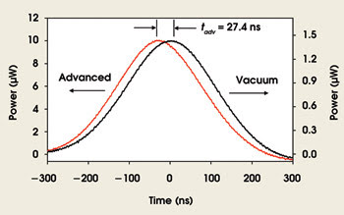
Anomalous dispersion : fast light
v_{g}<0 or v_{g}>c
The effect is to shift the peak of the pulse in time, but with the pulse shape staying the same
Just a move of the point of constructive interference occurs, both arise from the same effect: the shifting of the point of constructive interference to another point in space-time.
Daniel J. Gauthier and Robert W. Boyd, Fast Light, Slow Light and Optical Precursors: What Does It All Mean?, 2007

Slide 23
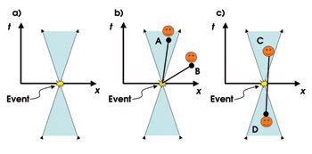
Anomalous dispersion : fast light
v_{g}<0 or v_{g}>c
Observers at space-time points in the blue cone can see the event and those outside the cone cannot
The flow of information within the light cone is said to be relativistically causal.
Hypothetical faster-than-light propagation of information is relativistically acausal, meaning that there is no direct time-ordered link between a cause and an effect
Daniel J. Gauthier and Robert W. Boyd, Fast Light, Slow Light and Optical Precursors: What Does It All Mean?, 2007

Slide 24
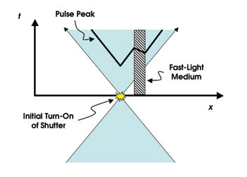
Anomalous dispersion : fast light
v_{g}<0 or v_{g}>c
All the information encoded on the waveform is available to be detected at the pulse front (although it might be difficult to measure in practice).
Thus, the fact that the peak of the pulse is advanced in time is not a violation of the special theory of relativity — so long as it never advances beyond the pulse front.
Daniel J. Gauthier and Robert W. Boyd, Fast Light, Slow Light and Optical Precursors: What Does It All Mean?, 2007
Notes:
The peak is advanced as it passes through the medium, but the pulse front is unaffected.

Slide 25
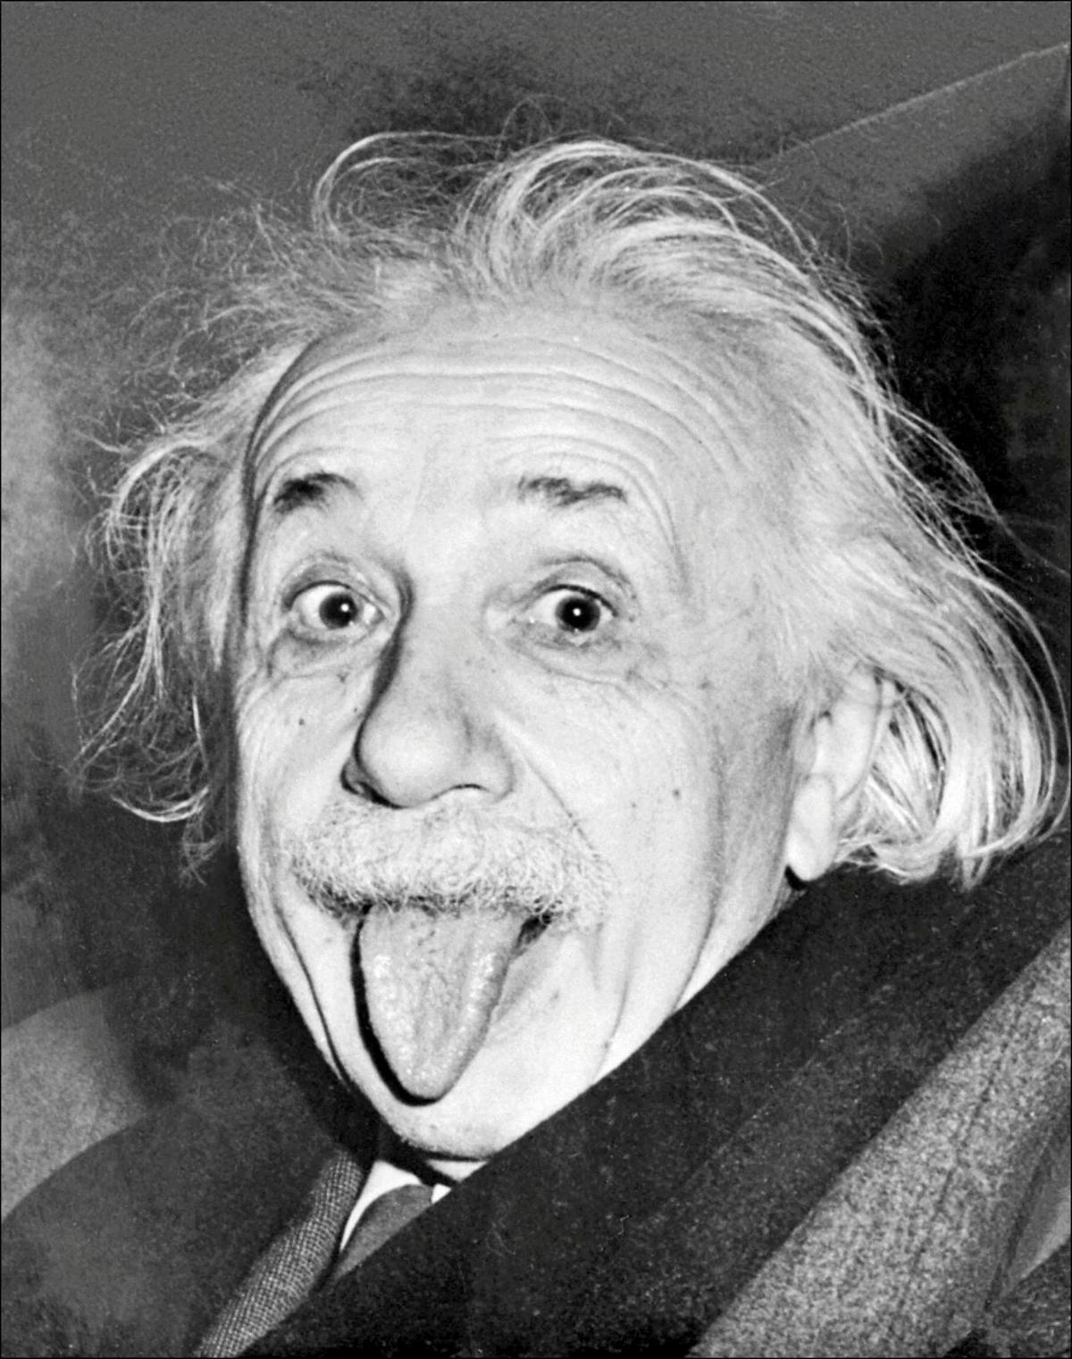
Fast light : what about causality?
v_{g}>c
No problem with Einsteinian causality, just because light travels at vg>c doesn't mean that information travels faster than the speed of light.

Slide 26
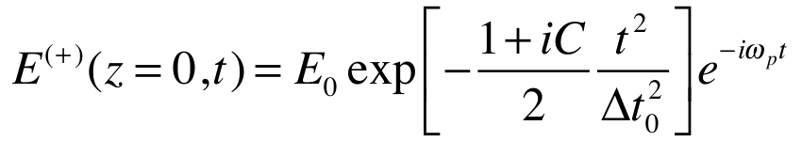
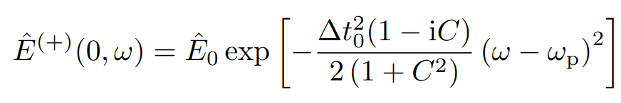
Frequency drift: chirped initial pulse
We now consider the propagation in a dispersive medium of a pulse which initially presents a chirp:
With C the chirp rate
FT

Slide 27
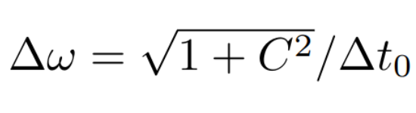
Frequency drift: chirped initial pulse
No initial chip :
With initial chip :
Impulse limited by fourier transform
Impulse is not limited by a Fourier transform

Slide 28
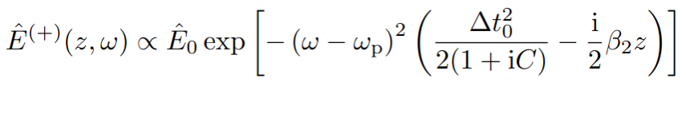
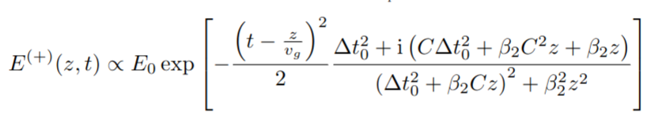
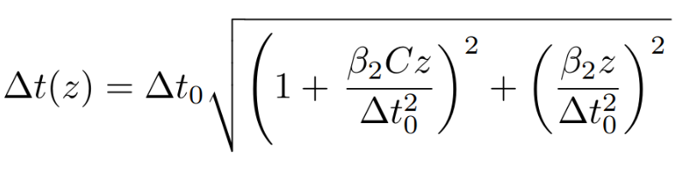
Frequency drift: chirped initial pulse
After propagation through the dispersive medium of thickness z, the field becomes:
We can therefore write down the impulse in the following form:
And we can finally extract the pulse duration:

Slide 29
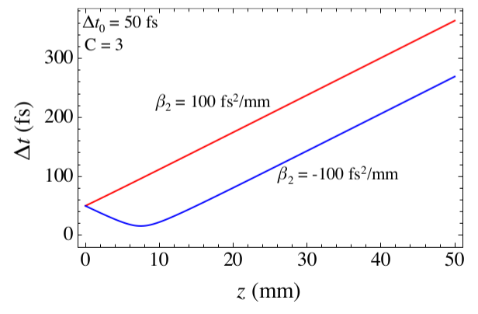
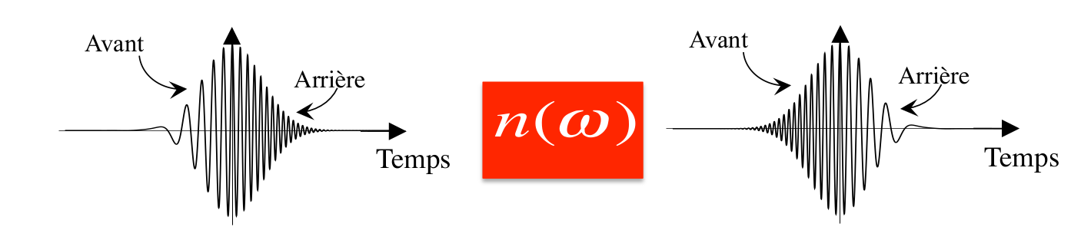
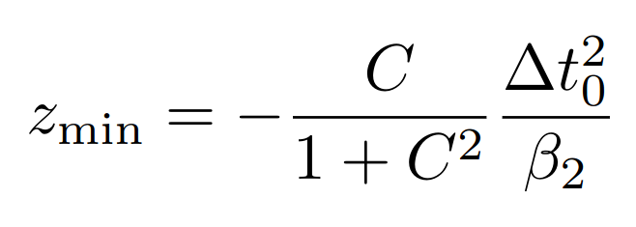
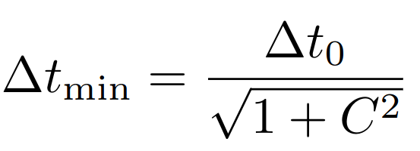
Frequency drift: chirped initial pulse
Front
Electric field
Front
Electric field
Back
Back
Time
Time
Compresses the pulse
Fabien Bretenaker, Antoine Browaeys, Ondes électromagnétiques, 2016

Slide 30
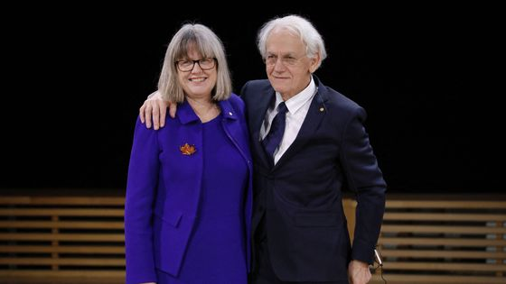
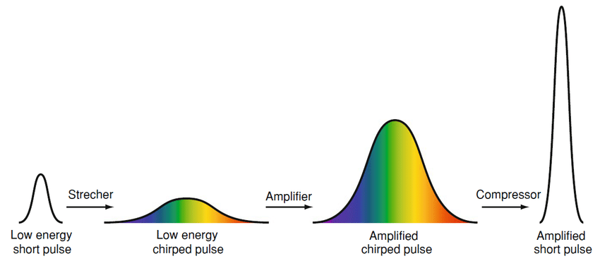
Frequency drift: chirped initial pulse
Donna Strickland & Gérard Mourou
Amplification without damaging optical components
Pulse lasers are used in precision surgical procedures (ophthalmology for cataract surgery and vision correction)
Satomi Shiraishi, Investigation of Staged Laser-Plasma Acceleration, 2014 Phd Thesis

Slide 31
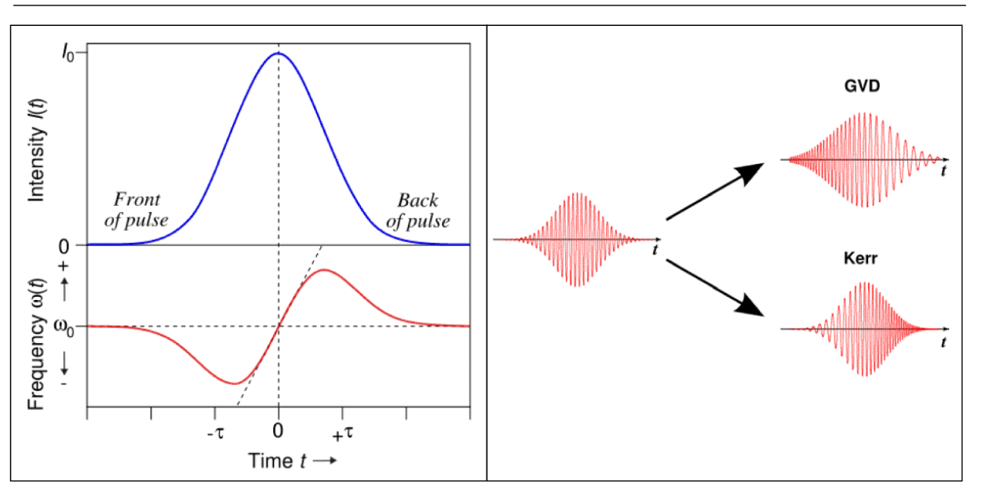
Phase self-modulation: Nonlinear effect
Linear effect → spectral content of the pulse remains unchanged along the propagation, dispersion is responsible for spreading the pulse:
Nonlinear effect→Phase self-modulation (PSM), result to a change in the frequency spectrum, no change in the temporal form
Kuriakose, V. C., & Porsezian, K. Elements of optical solitons: An overview. Resonance, (2010)

Slide 32
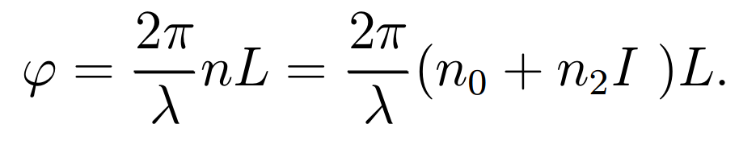
Phase self-modulation: Nonlinear effect
The phase of the pulse depends on the intensity of the beam
The optical pulse travels over a distance L through an optical fiber, its shift in the phase is given by:
Linear frequency chirp with the GVD
Variation of instantaneous frequency by phase auto-modulation, Nonlinear frequency chirp
Kuriakose, V. C., & Porsezian, K. Elements of optical solitons: An overview. Resonance, (2010)

Slide 33



Phase self-modulation: Nonlinear effect
We observe the propagation of a pulse, described as a scalar field, in an isotropic medium, its field is written as:
Where A(z,t) is the envelope of the pulse and ⍵_{p} its central frequency, the intensity of this pulse, will introduce, through the Kerr effect assumed to be instantaneous, a modification of the index:

Slide 34


Phase self-modulation: Nonlinear effect
So the additional nonlinear phase, accumulated by this wave after a length L, will be written as:
Since this phase varies with time, it leads to a variation in the instantaneous frequency of the beam:

Slide 35




Phase self-modulation: Nonlinear effect
By injecting the field into the propagation equation and making the slowly varying envelope approximation, we obtain:
And like in the linear case,by performing a second-order Taylor expansion around the center frequency ⍵_{p} of the pulse spectrum, we obtain:
With:
Where:

Slide 36



Phase self-modulation: Nonlinear effect
From the two previous equations and by observing the pulse in a reference frame moving at the group velocity, and by introducing a delayed time:
we can therefore rewrite the expression:
Where:

Slide 37

Phase self-modulation: Nonlinear effect
we finally obtain:
Ultimately, we find the same nonlinear Schrödinger equation as in the case of a continuous beam undergoing self-focusing and diffraction, with the following correspondence:
Spatial soliton
Temporal soliton
Diffraction
Dispersion
Self-focalisation
Self-modulation
x
τ
Impulsion
Beam

Slide 38




Phase self-modulation: Nonlinear effect
In the same way as in the transverse dimension, the equation admits solutions that propagate without temporal deformation, that is, a temporal soliton:
With:
Creation of a soliton that propagates without deformation
Kuriakose, V. C., & Porsezian, K. Elements of optical solitons: An overview. Resonance, (2010)

Slide 39

Phase self-modulation: Nonlinear effect
For the dispersion and self-phase modulation to compensate each other, D₀ and n₂ must have opposite signs.
One way to obtain temporal solitons is to have materials where n₂ < 0 and D₀ > 0
Kuriakose, V. C., & Porsezian, K. Elements of optical solitons: An overview. Resonance, (2010)

Slide 40
Conclusion
The propagation of pulses is strongly influenced by the dispersion of the medium
Linear effect →Group velocity dispersion
Responsible for pulse spreading and the appearance of a frequency linear chirp
High frequencies propagate less quickly than low frequencies
possibility to use chirped initial pulse to compress the pulse

Slide 41
Conclusion
The propagation of pulses is strongly influenced by the dispersion of the medium
Nonlinear effect →Self-phase modulation
Result to a change in the frequency spectrum with the appearance of frequency nonlinear chirp
No change in the temporal form

Slide 42
Conclusion
The propagation of pulses is strongly influenced by the dispersion of the medium
Linear effect →Group velocity dispersion +
Nonlinear effect →Self-phase modulation
Compensation for both effects
Creation of a soliton that propagates without deformation

Slide 43
Conclusion
The propagation of pulses is strongly influenced by the dispersion of the medium
In telecommunications, understanding dispersion is essential
advanced medical techniques, such as magnetic resonance imaging (MRI) and some forms of ultrasound imaging
renewable energy & solar cells
Describe the propagation of an electric field along z in 3D and 1D in a Rb cell

